Slide 1


SQL Server and PowerShell walk into a bar…
Mikey Bronowski

Slide 2


Thank You to our Sponsors!
Gold:

Slide 3

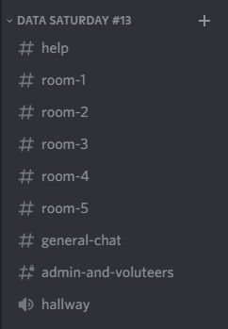

Join The PASSMN Discord Server
https://discord.gg/GajGTFVT28
We’re using Discord as our background chat and communication platform to augment our Virtual Events. This way you can chat with all attendees and continue the conversation after the sessions/event.
Note: Change your Nickname to your First & Last Name so it’s easier to know who you are.
Help Chat:
Session Chat & Q/A:
Example:
Voice Chat:

Slide 4





Mikey Bronowski
Husband | Dad | SQL DBA | MCT | Microsoft Data platform MVP
Blog:
Bronowski.IT
Email:
MikeyBronowski@gmail.com
LinkedIn:
https://www.linkedin.com/in/mikeybronowski
Twitter:
https://twitter.com/MikeyBronowski

Slide 5
AGENDA
dbatools – managing SQL Server from command prompt
Pester – framework to test PowerShell
dbachecks – SQL Server validation
ImportExcel – managing Excel without MS Office installed

Slide 6

dbatools
SQL Server Management Studio as command-prompt
Chrissy LeMaire (@cl)

Slide 7
dbatools
Project website https://dbatools.io
GitHub repository https://github.com/sqlcollaborative/dbatools
Over 600 functions *-Dba*
Book https://www.manning.com/books/learn-dbatools-in-a-month-of-lunches

Slide 8

Pester
Unit testing framework for PowerShell
Jakub Jareš (@nohwnd)

Slide 9
Pester
Project website https://pester.dev
Supported on PowerShell 3 and later
Version 3.4.10 preinstalled on Windows 10 / Server 2016
Current version 5
Assertions https://pester.dev/docs/assertions/should-command

Slide 10
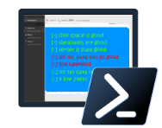
dbachecks
Module based on Pester to for SQL Server validation.
Rob Sewell (@sqldbawithbeard)

Slide 11
dbachecks
Project website https://dbachecks.io
GitHub Repository https://github.com/sqlcollaborative/dbachecks
Functions *-Dbc*
Over 130 checks

Slide 12


ImportExcel
Managing Excel files without Microsoft Office (based on EPPlus)
Doug Finke (@dfinke)

Slide 13
ImportExcel
GitHub repository https://github.com/dfinke/ImportExcel
Based on EPPlus (< v5)
Import-Excel / Export-Excel
Open-ExcelPackage / Close-ExcelPackage

Slide 14

PASSMN
We’re always looking for speakers, sponsors, and new members. Contact us!
Minnesota Data and Analytics User Group Azure Data Tech Group Community Member
Meetup:
https://www.meetup.com/MN-SQL-Server-User-Group-PASSMN/
Email:
board@passmn.com
LinkedIn:
https://www.linkedin.com/groups/2034949/
Twitter:
@PASSMN - https://twitter.com/PASSMN
Code of Conduct:
https://passmn.com/code-of-conduct/

